Slide 1
How Multilingualism Affects Economic Freedom
Witt Shoaf
CSU-Global
Dr. Steve Chung
Notes:
In this presentation I will discuss the results of my research while taking the capstone class with CSU-Global – Business Intelligence and Data Analytics.

Slide 2
Understanding the Question
Prior analysis on effects of being multilingual
Holistic analysis of larger impact that being multilingual has
What is economic freedom
Notes:
The research intended to analyze the effect of a country being officially multilingual on its economic freedom score.
This thought process was started after considering that in pop culture we are taught that being multi-lingual is very beneficial for individuals.
Since economic growth relates to the wellbeing of a people, this research is targeting increasing our knowledge of how to positively impact economic growth.
We feel that prior studies on multilingualism were underserving the impact that language has on economies as a whole. This research is set to fill a part of that gap.
What is economic freedom and why are we using it as a basis for measuring economic strength.
Economic freedom is described by the Fraser Institute such. Individuals have economic freedom when property they acquire without the use of force, fraud, or theft is protected from physical invasions by others and they are free to use, exchange, or give their property as long as their actions do not violate the identical rights of others. (Fraser Institute, 2023).
We believe that this value which Fraser has been recording for years will provide some semblance of representation of economic strength.

Slide 3
Impact of Findings
How Economic Freedom impacts citizens
How Economic Freedom impacts consumers
Notes:
Taking what we just learned about economic freedom let us consider how it impacts two interchangeable groups, citizens and consumers. IF a country has strong justice systems, government institutions, and property laws but is not overly controlling it will most likely have a good rating on the economic freedom index. What goes hand in hand with these things is typically a country being stronger economically than others without these things. Knowing that economic freedom and economic growth are related the findings of this research can impact how policy makers and business owners make strategic decision regarding future courses of action. (Brkic, 2020).

Slide 4
Data Sources
Fraser Institute
University of Ottawa
Wikipedia
Notes:
Our data sources were:
The World Economic Freedom Index by Fraser Institute which goes back to 1970 for 165 countries.
Wikipedia Individual Country pages to determine how many languages are officially recognized
University of Ottawa’s List of 55 Bilingual Countries in the world.
Multiple sources were used when researching the number of languages each country in the Fraser Institutes dataset had. This was done to reduce the number of error a single dataset might have. Sources for both language searches have been provided in the references and are font color red.

Slide 5
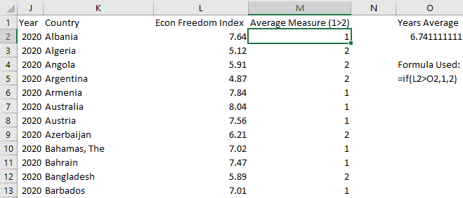
Data Rework
Figure #1
Example of Average Data Rework
Using averages for Economic Freedom
Assumptions around language adoption
Note. Produced within excel for purposes of this presentation.
Notes:
The data itself was required being reworked after its initial collection. To help simplify the analysis and reading it results, work was done to codify everything as binary values. If a country has one official language it has 1 in the language variable. If it has two or more official languages it has 2 in the language variable. For Economic Freedom values, the average for each year was found. Then if the country for that particular year had a value greater than the average it was given a 1 and if it was less it was given a 2. Missing values (of which there were 85 in the first year of data) were left blank so as not to skew the data. On the slide you can see a simply example of how the economic freedom index was transferred to average values. The use of averages was decided upon to help reduce outliers and make the data easier to read and handle (Overbay, 2004).

Slide 6



Analytical Software
SAS
Python
Excel
Notes:
The software used in this analysis was primary SAS for Academics, Excel, and Python. SAS was selected as the primary due to its ready use library of statistical test that we were already familiar with. Excel was used to house the data and for easy data manipulation during the data reworking stage. Finally, Python was uses lightly to rework some visuals. All images taken form Google Images with sourcing from Wikipedia.

Slide 7
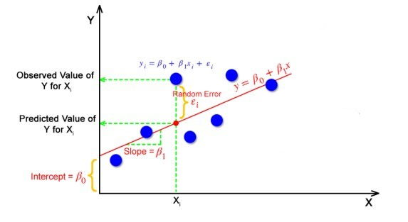
Analysis Method
Linear Regression
Notes:
Regression was selected as the means for testing the hypotheses due to its commonplaceness in statistical analysis. Linear Regression for anyone who doesn’t know is a, “form of analysis (that) estimates the coefficients of the linear equation, involving one or more independent variables that best predict the value of the dependent variable. Linear regression fits a straight line or surface that minimizes the discrepancies between predicted and actual output values.” (IBM, 2023). Using linear regression within SAS allows for rapid iterations of the analysis to be conducted and for newly reworked data to be quickly analyzed for flaws.
Picture source (Mali, 2021).

Slide 8
Findings
Multiple Languages shows a relationship of lower economic freedom being experienced.
Linear Regression Formula= 1.40451 + (language count) * 0.05363
Notes:
The findings from the linear regression as shown as the formula. As can be seen on the slide the impact of a multiple official languages negatively impacts the average economic freedom index value to the point that it rounds to 2 (or lesser than average). This finding confused the researchers as their internally held beliefs disagreed with the findings. After due consideration we discovered that there was serious flaws in our approach that could have led to this development which were.

Slide 9
Findings Limitations
Inherent limitations of data availability
Scale and scope of analysis leading to incorrect outcome
Failure in current analysis provides a route to conduct the analysis better in the future
Notes:
In the first place the data itself was limited to only 165 countries. Of those countries not all had values going throughout the entire dataset. Some countries only started reporting after several years of data were present for others. This limited the impact that their language count would have on the overall study.
Secondly after considering where the analysis could have gone wrong, we realized that by not breaking the represented countries into groups based on the general size of each economy we were comparing different situations. IT is bast to face the reality of our world and then conduct research that deal with that reality as opposed to ignoring it. Certain countries that have to deal with post colonialism borders dictating which groups of people were within their borders have had a harder time stabilizing and growing their economies. The relative impacts of multi-languages might be lesser for these types of situations as opposed to more mature countries that have naturally combined several diverse groups of people over a very long timer period.(Acemoglu, 2014). This study failed to address these topics.

Slide 10
Recommendations
Understanding the limitations of the data still tell a story
World Leaders might find the data more useful than business owners.
Notes:
Ultimately , the study does show evidence that language does impact economic freedom, but the results are inconclusive. This study provides a framework to analyze how language impacts economic freedom while drawing attention to the need to look at economies differently and group them, thoughtfully to pull out the correct conclusion.
After considering how the findings might be most impactful, we realize that business owners and local policy makers might not actually find much value. International help organizations could in part use this data/research to start further investigations into how language impacts economies and the individuals within them. Additionally, this research add more material to the conversation that properly considering the underlying data is important when analyzing data, and that drawing conclusions too quickly might lead to bad recommendations from said studies.

Slide 11
References
Fraser Institute. (2023). Economic Freedom Basics. Fraser Institute. Retrieved from https://www.fraserinstitute.org/economic-freedom/economic-freedom-basics#:~:text=Individuals%20have%20economic%20freedom%20when,the%20identical%20rights%20of%20others.
Brkic, I. (2020). The relationship between economic freedom and economic growth in EU countries. Jaume I University. Retrieved from https://www.tdx.cat/bitstream/handle/10803/669302/2020_Tesis_%20Brkic_Ivana.pdf?sequence=1
IBM. (2023). Linear Regression. IBM. Retrieved from https://www.ibm.com/topics/linear-regression#:~:text=Resources-,What%20is%20linear%20regression%3F,is%20called%20the%20independent%20variable.
Acemoglu, D. (2014). Indirect Rule and State Weakness in Africa: Sierra Leon in Comparative Perspective. Harvard University. Retrieved from https://scholar.harvard.edu/files/jrobinson/files/indirect_rule_nber_4_0.pdf.
Osborne, J. (2004). The power of outliers. University of Massachusetts. Retrieved from https://scholarworks.umass.edu/cgi/viewcontent.cgi?article=1139&context=pare
Mali, K. (2021). Everything you need to know about linear regression!. Analytics Vidhya. Retrieved from https://www.analyticsvidhya.com/blog/2021/10/everything-you-need-to-know-about-linear-regression/
Data Validation Sources:
UOttawa. (2023). The 55 Bilingual countries in the world. University of Ottawa. Retrieved from https://www.uottawa.ca/clmc/55-bilingual-countries-world
Wikipedia. (2023). Wikipedia (Individual Country Searches). Wikipedia. Retrieved from https://en.wikipedia.org/wiki/List_of_multilingual_countries_and_regions
Notes:
References

